Slide 1

Florida KIDS COUNT!
2017
Norín Dollard, Ph.D.
Department of Child & Family Studies
Louis de la Parte Florida Mental Health Institute
College of Behavioral & Community Sciences
Florida Children and Youth Cabinet – Technology Workgroup
February 24, 2017

Slide 2
Agenda
Annie E. Casey & KIDS COUNT overview – national perspective
Florida KIDS COUNT – how it differs
Technology Workgroup
  What are other states doing? Portal? Dashboard? Both?

Slide 3
Annie E. Casey Foundation
Founded in 1949, the Annie E. Casey Foundation was created to help America’s kids have a brighter future by
  strengthening families,
  building stronger communities, and,
  ensuring access to opportunity.

Slide 4
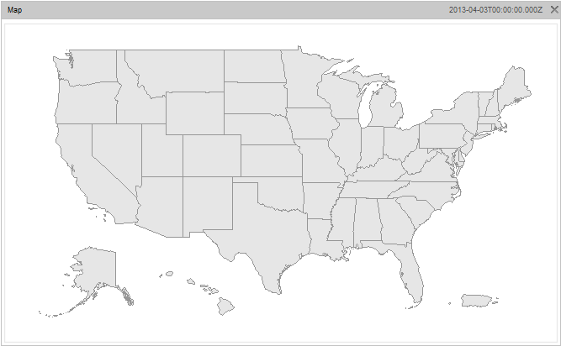















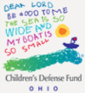


































KIDS COUNT State Network
KIDS COUNT State Network

Slide 5

About KIDS COUNT
Notes:
The KIDS COUNT Data Book provides state-by-state data for 16 indicators of child well-being.
These indicators are organized into four domains: economic well-being, health, education and family and community. This data is used to create a composite score that allows us to rank states overall, by domain, and by individual indicators.
Every year we look at the direction in which each state is going. Each Data Book is a call to action of some kind

Slide 6
Building a brighter future…
One way Casey achieves this is by providing reliable data analysis through the KIDS COUNT grants in all 50 states, Washington, D.C., Puerto Rico and the Virgin Islands
Casey funds these groups to collect data and report on the most critical measures of child and family well-being in their states.
http://datacenter.kidscount.org/
Notes:
Diverse network – 1/3rd non-profit state-level child advocacy organizations, 1/3 university centers and 1/3rd other groups like community foundations, state government.

Slide 7
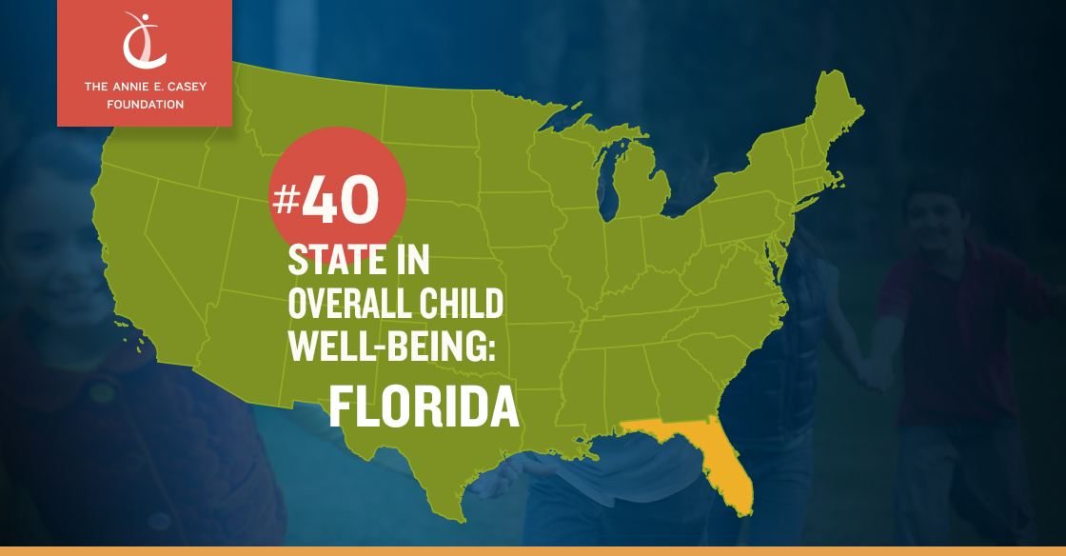
Notes:
Top 5 2016 - Minnesota, Massachusetts, Iowa, New Hampshire & Connecticut

Slide 8




Four Domains of Child Well-Being
Economic
Well-Being
Family and
Community
Education
Health
Notes:
These indicators are organized into four domains: economic well-being, health, education and family and community. This data is used to create a composite score that allows us to rank states overall, by domain, and by individual indicators.

Slide 9
Florida’s Domain Ranking 44
Economic
Well-Being
FLORIDA
Children in poverty |  | Children whose parents lack secure employment |  | Children living in households with a high housing cost burden |  | Teens not in school and not working
2014 |  | 2014 |  | 2014 |  | 2014
24% |  | 32% |  | 41% |  | 8%
948,000 CHILDREN |  | 1,283,000 CHILDREN |  | 1,672,000 CHILDREN |  | 78,000 TEENS
WORSENED |  | WORSENED |  | IMPROVED |  | IMPROVED
2008 | 18% | 2008 | 28% | 2008 | 49% | 2008 | 10%
Notes:
Children in poverty is the percentage of children under age 18 who live in families with incomes below 100 percent of the U.S. poverty threshold, as issued each year by the U.S. Census Bureau. …The data are based on income received in the 12 months prior to the survey.” SOURCE: U.S. Census Bureau, American Community Survey.”
Children whose parents lack secure employment - is the share of all children under age 18 living in families where no parent has regular, full-time, year-round employment.” SOURCE: U.S. Census Bureau, American Community Survey.
Children living in households with a high housing cost burden is the percentage of children under age 18 who live in households where more than 30 percent of monthly household pretax income is spent on housing-related expenses, including rent, mortgage payments, taxes and insurance. SOURCE: U.S. Census Bureau, American
Community Survey.
Teens not in school and not working is the percentage of teenagers between ages 16 and 19 who are not enrolled in school (full or part time) and not employed (full or part time). SOURCE: U.S. Census Bureau, American Community Survey.

Slide 10
Florida’s Domain Ranking 30
Education
FLORIDA
Children not attending preschool |  | Fourth graders not proficient in reading |  | Eighth graders not proficient in math |  | High school students not graduating on time
2012-14 |  | 2015 |  | 2015 |  | 2012-13
50% |  | 61% |  | 74% |  | 24%
223,000 CHILDREN |  | N.A. |  | N.A. |  | N.A.
WORSENED |  | IMPROVED |  | WORSENED |  | IMPROVED
2007-09 | 49% | 2007 | 66% | 2007 | 73% | 2007/08 | 33%
Notes:
Children not attending preschool is the percentage of children ages 3 and 4 who were not enrolled in nursery school or preschool during the previous two months. Source: The 3 Year American Community Survey was used to
increase accuracy of the estimates. SOURCE: U.S. Census Bureau, American Community Survey.
Fourth graders not proficient in reading is the percentage of fourth-grade public school students who did not reach the proficient level in reading as measured by the National Assessment of Educational Progress (NAEP). SOURCE: U.S. Department of Education, National Center for Education Statistics, National Assessment of Educational Progress.
Eighth graders not proficient in math is the percentage of eighth-grade public school students who did not reach the proficient level in math as measured by the National Assessment of Educational Progress (NAEP). SOURCE: U.S. Department of Education, National Center for Education Statistics, National Assessment of Educational Progress.
High school students not graduating on time is the estimated percentage of an entering freshman class not graduating in four years. SOURCE: U.S. Department of Education, National Center for Education Statistics, Common Core of Data (CCD).

Slide 11
Florida’s Domain Ranking 47
Health
FLORIDA
Low-birthweight babies |  | Children without health insurance |  | Child and teen deaths per 100,000 |  | Teens who abuse alcohol or drugs
2014 |  | 2014 |  | 2014 |  | 2013-14
8.7% |  | 9% |  | 26 |  | 6%
19,065 BABIES |  | 378,000 CHILDREN |  | 1,131 DEATHS |  | 80,000 TEENS
IMPROVED |  | IMPROVED |  | IMPROVED |  | IMPROVED
2008 | 8.8% | 2008 | 18% | 2008 | 31 | 2007/08 | 7%
Notes:
Low-birthweight babies is the percentage of live births weighing less than 2,500 grams (5.5 pounds). SOURCE: Centers for Disease Control and Prevention, National Center for Health Statistics, Vital Statistics.
Children without health insurance is the percentage of children under age 18 not covered by any health insurance. SOURCE: U.S. Census Bureau, American Community Survey.
Child and teen deaths is the number of deaths, from all causes, to children between ages 1 and 19 per 100,000 children in this age range. SOURCES: Death Statistics: Centers for Disease Control and Prevention, National
Center for Health Statistics, Vital Statistics. Population Statistics: U.S. Census Bureau, Population Estimates.
Teens who abuse alcohol or drugs is the percentage of teens ages 12 to 17 reporting dependence on or abuse of either illicit drugs or alcohol in the past year. SOURCE: Substance Abuse and Mental Health Services Administration, National Survey on Drug Use and Health.

Slide 12
Florida’s Domain Ranking 35
Family and
Community
FLORIDA
Children in single parent families |  | Children in families where the household head lacks a high school diploma |  | Children living in high poverty areas |  | Teen births per 1,000
2014 |  | 2014 |  | 2010-2014 |  | 2014
40% |  | 12% |  | 15% |  | 23
1,547,0000 CHILDREN |  | 492,000 CHILDREN |  | 594,000 CHILDREN |  | 12,816 BIRTHS
WORSENED |  | IMPROVED |  | WORSENED |  | IMPROVED
2008 | 36% | 2008 | 13% | 2006-10 | 8% | 2008 | 40
Notes:
Children in single-parent families is the percentage of children under age 18 who live with their own unmarried parent, either in a family or subfamily. In this definition, single-parent families may include cohabiting couples. SOURCE: U.S. Census Bureau, American Community Survey.
Children in families where the household head lacks a high school diploma is the percentage of children under age 18 living in households where the household head does not have a high school diploma or equivalent. SOURCE: U.S. Census Bureau, American Community Survey.
Children living in high-poverty areas is the percentage of children under age 18 who live in census tracts where the poverty rates of the total population are 30 percent or more. SOURCE: U.S. Census Bureau, American Community Survey.
Teen births is the number of births to teenagers between ages 15 and 19 per 1,000 females in this age group. Population Statistics: U.S. Census Bureau, Population Estimates.

Slide 13
Casey data sources for state rankings
Domain: Economic Well Being
U.S. Census – American Community Survey
    Children in poverty
    Children whose parents lack secure employment
    Children living in households with a high housing cost burden
    Teens not in school and not working

Slide 14
Casey data sources for state rankings
Domain: Education
U.S. Census – American Community Survey
    Children not attending preschool
U.S. DoE, National Center for Educational Statistics, National Assessment of Educational Progress
    Fourth graders not proficient in reading
    Eighth graders not proficient in math
U.S. DoE, National Center for Educational Statistics, Common Core of Data
  High school students not graduating on time

Slide 15
Casey data sources for state rankings
Domain: Health
CDC, National Center for Health Statistics, Vital Statistics
    Low-birthweight babies
    Child and teen deaths*
U.S. Census – American Community Survey
  Children without health insurance
U.S. SAMHSA National Survey on Drug Use and Health
  Teens who abuse alcohol or drugs
*uses ACS population data as the denominator

Slide 16
Casey data sources for state rankings
Domain: Family & Community
U.S. Census – American Community Survey
    Children in single – parent families
    Children in families where the household head lacks a high school diploma
    Children living in high – poverty areas
CDC, National Center for Health Statistics, Vital Statistics
  Teen births*
*uses ACS population data as the denominator

Slide 17
So how is national v. Florida data different?
Casey can only use sources of data that are directly comparable for state to state comparisons
Florida data is more current, typically
There is a greater variety of data sources available
We can tailor our efforts to the issues are most salient here
We can get data down to the county level

Slide 18
Florida KIDS COUNT
In addition to the annual Data Book Casey publishes directly, Florida KIDS COUNT produces topical and geographically-specific briefs for planning and increasing awareness, such as:
  Children’s health insurance coverage
  Parental incarceration
  What Would It Take Florida?
http://floridakidscount.org/

Slide 19
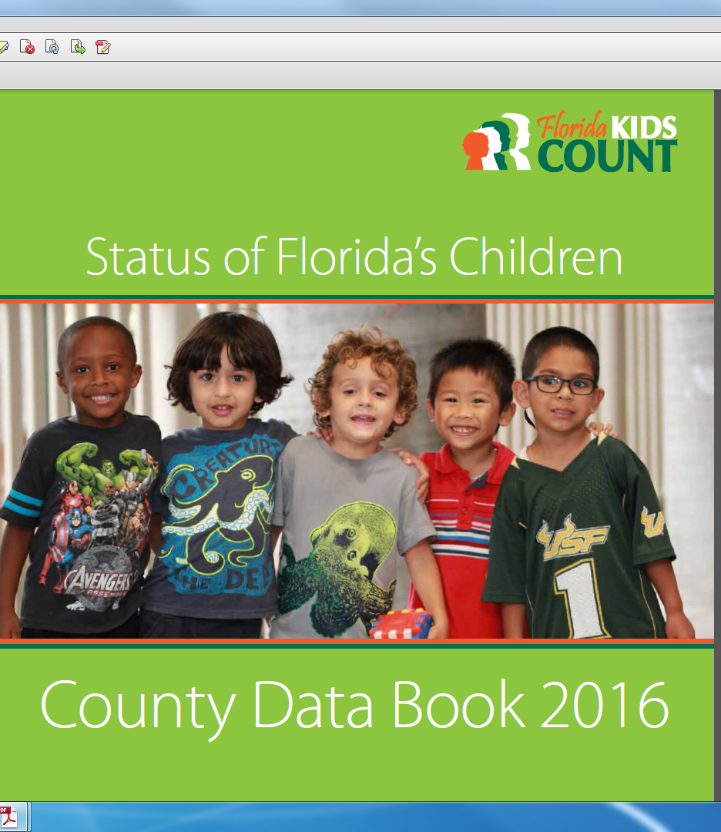

Slide 20
2016 Florida Data Book
Provides state and county level profiles including data on population demographics, economic well-being, educational attainment, health indicators and risk factors.
Uses publicly available data from national sources including the U.S. Census as well as state and county level data from sources such as the Department of Juvenile Justice, the Office of Economic and Demographic Research and the Florida Department of Health.

Slide 21
At the 1/30 Cabinet Meeting they adopted the following indicators:
Percent of low birthweight babies
Percent of eligible 3 and 4 year old children in school
Percent of children living at or below 120% of the federal poverty level
Percent of infants and toddlers without health insurance
Children under 12 years old at the age of first arrest

Slide 22
At the 1/30 Cabinet Meeting they adopted the following indicators:
Percent of children with verified maltreatment without additional reports in the following six months
Percent of children with intellectual disabilities in out-of-home care
Percent of children who attain proficiency in their 4th grade reading
Number of preventable child deaths

Slide 23
What might a dashboard using local data look like?

Slide 24
Florida’s Economic Well-Being
Children in poverty |  | Unemployment Rate |  | Children living in areas of concentrated poverty |  | High housing cost burden
2014 |  | 2015 |  | 2010-2015 |  | 2015
24.2% |  | 5.4% |  | 13.5% |  | 41.7%
962,857 CHILDREN |  | 522,065 PEOPLE |  | 547,478 CHILDREN |  | 3,300,592 HOUSEHOLDS
WORSENED |  | IMPROVED |  | WORSENED |  | IMPROVED
2009 | 21.5% | 2010 | 11.1% | 2006-2010 | 8.5% | 2010 | 41.8%
Notes:
Children in poverty - Small Area Income and Poverty Estimates (SAIPE), 2014 - Under 18 in Poverty Count & ACS for denominator
Children Living in High Poverty Areas- Special Analysis by the Population Reference Bureau (PRB), 2010-2014 (Provided by Jean) & ACS for denominator
Unemployment Rate Bureau of Labor Statistics, 2015
High Housing Cost Burden Shimberg, Household Cost Burden, 2015 (more than 30% of income spent)

Slide 25
Florida’s Education Domain
Students not ready for kindergarten |  | Fourth graders not proficient in reading |  | Eighth graders not proficient in math |  | High school students not graduating on time
2013-14 |  | 2015 |  | 2015 |  | 2014-15
8.6% |  | 73% |  | 81% |  | 22.1%
17,262 CHILDREN |  | N/A |  | N/A |  | 44,257
N/A |  | N/A |  | N/A |  | IMPROVED
 |  |  |  |  |  | 2011-2012 | 25.5%
Notes:
Students not ready for Kindergarten SOURCE: Florida Kindergarten Readiness Screener Results (ECHOS) by School, 2013-14 SPAR (Florida Department of Education [FLDOE])
Fourth graders not proficient in reading add levels 1-3 equivalent to inadequate, below satisfactory, satisfactory on the Florida Standard Assessment [FSA]). SOURCE: FLDOE Spring 2015 Retrofitted District Results (add levels 1-3 equivalent to inadequate, below satisfactory, satisfactory on the Florida Standard Assessment [FSA])
Eighth graders not proficient in math FLDOE Spring 2015 Retrofitted District Results (add levels 1-3 equivalent to inadequate, below satisfactory, satisfactory on the FSA)
High school students not graduating on time SOURCE: FLDOE, 2014-2015

Slide 26
Florida’s Health Domain
Low-birthweight babies |  | Children without health insurance |  | Teen births |  | Teens who abused alcohol or drugs past 30 days
2015 |  | 2014 |  | 2015 |  | 2014
8.6% |  | 9.7% |  | 20.4% |  | 36.3%
19,367 BABIES |  | 406,126 CHILDREN |  | 11,956 BIRTHS |  | 11,157 TEENS
IMPROVED |  | IMPROVED |  | IMPROVED |  | IMPROVED
2010 | 8.7% | 2009 | 24.9% | 2010 | 32.1% | 2010 | 43.6%
Notes:
Low birthweight babies - Florida Community Health Assessment Resource Tool Set (CHARTS), 2015
Children Without Health Insurance: Small Area Health Insurance Estimates [SAHIE], 2014 - Under 18 Uninsured
Teen births - Florida CHARTS, 2015
High School Teens who Used Alcohol or any Illicit Drug in the Past 30 Days Source: Florida Youth Substance Abuse Survey (FYSAS), 2014

Slide 27
Florida’s Family & Community Domain
Children in single parent families |  | Births to Mothers Without a High School Diploma |  | Verified maltreatment per 1000 |  | Youths arrested per 1000 ages 10-17
2011-2015 |  | 2015 |  | 2015-2016 |  | 2014-15
35.7% |  | 12.8% |  | 9.4% |  | 23
1,253,515 CHILDREN |  | 28,814 CHILDREN |  | 38,843 CHILDREN |  | 42,211 YOUTH
WORSENED |  | IMPROVED |  | N/A |  | IMPROVED
2006-2010 | 33.2% | 2010 | 17.2% |  |  | 2009-10 | 40.4
Notes:
Children in Single Parent Families - ACS, 2011-2015 B09002 Male Householder and Female Householder (no wife/husband present respectively)
Births to Mothers Without a High School Diploma - Florida CHARTS, 2015
Children with Verified Maltreatment- Number of Children with Verified Maltreatment, FY 2015-2016 (Provided by Lana) 11 month data
Youth contacts in the juvenile justice system, 2014-2015 - FLDJJ, 2014-2015

Slide 28
Examples of Portals & Dashboards
California – has a portal with lots of data sets
  Kind of busy, but comprehensive
Colorado – has a simple dashboard http://co9to25.org/who-we-are/how-colorado-9to25-works/co9to25-indicators-handout-july-2013/
  Does not look like administrative data
Connecticut https://www.cga.ct.gov/kid/rba/results.asp
Notes:
List of Children’s Cabinets http://forumfyi.org/childrens-cabinet-network-0

Slide 29


Slide 30
Examples of Portals & Dashboards
Louisiana http://www.kidsdashboard.la.gov/

Slide 31
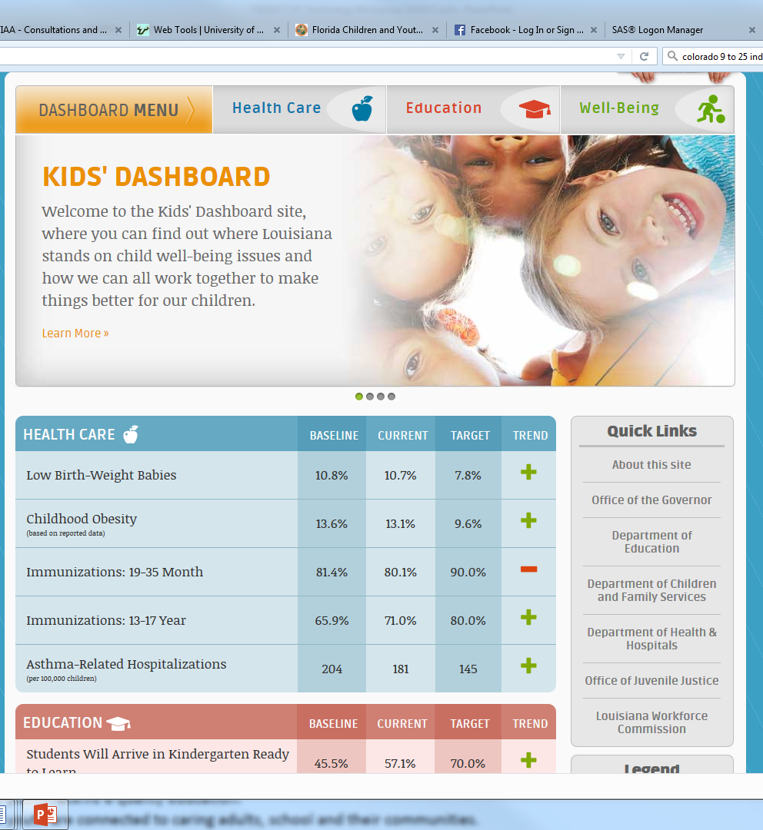

Slide 32
Examples of Portals & Dashboards
Maryland
  http://goc.maryland.gov/2014results
  Organizes 28 indicators into 8 domains

Slide 33
Examples of Portals & Dashboards
New York State Council on Children & Families
KWIC – Kids Well-being Indicator Clearinghouse http://ccf.ny.gov/council-initiatives/kids-well-being-indicators-clearinghouse-kwic/

Slide 34


Slide 35
Examples of Portals & Dashboards
Vermont
http://humanservices.vermont.gov/copy_of_ahs-results-scorecard

Slide 36


Slide 37
Portals and dashboard
Discussion

Slide 38
Thank you
Questions?
Norín Dollard, Ph.D.
dollard@usf.edu
(813) 974-3761
Like us on Facebook & follow us on Twitter @FLKidsCount

